Slide 1
Brand Logo
Course Title
Notes:
In this slide, add the course title and brand logo.

Slide 2
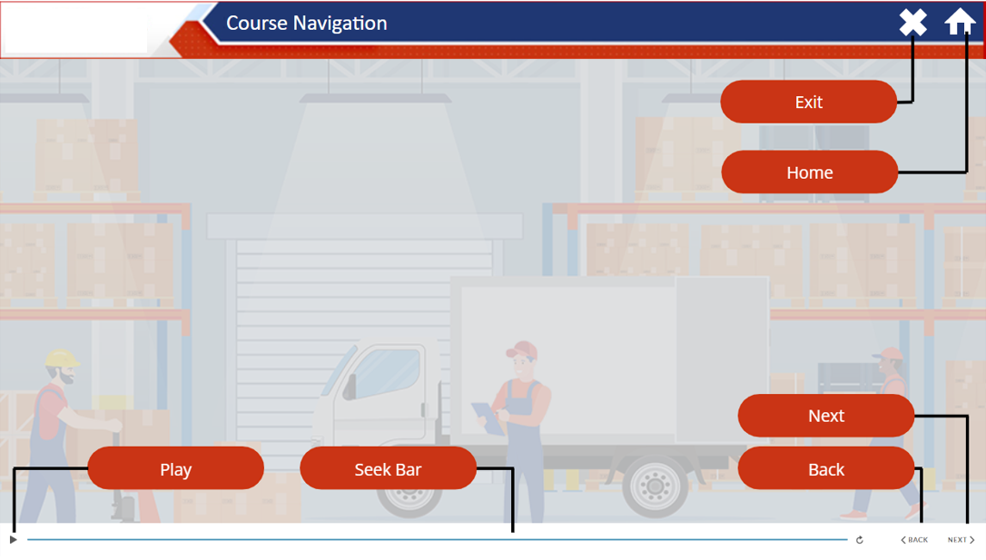
Brand Logo
Notes:
The focus of this slide will be on navigation control, aiding learners in navigating throughout the course. Introducing users to the navigation of the screen enhances their learning experience.

Slide 3
Course Objectives
Brand Logo
Course Objectives
In this course we will learn about
Objective 1
Objective 2
Objective 3
Objective 1
Click on each tab to learn more
Click on each tab to learn more
Click on each tab to learn more
Notes:
It's crucial to establish the objectives of the course at the beginning of the course.
Within this slide, clearly state the course objectives that you aim to achieve.

Slide 4
Topic 01 – Topic Tittle will come here
Brand Logo
Course Objectives
On screen content could be :
Image
Flow chart
On screen Text
Objective 1
Objective 2
Objective 3
This Dummy place holder is just for reference
Click on each tab to learn more
Notes:
Courses typically comprise multiple topics. Each topic's content and explanations should be presented on-screen, accompanied by a synchronized voice-over for enhanced comprehension.

Slide 5
Sub-Topic 01 – Sub-Topic Tittle will come here
Brand Logo
Course Objectives
On screen content could be :
Image
Flow chart
On screen Text
Click on each tab to learn more
Click on each tab to learn more
Click on each tab to learn more
Notes:
Each topic could have multiple subtopic or screen.

Slide 6
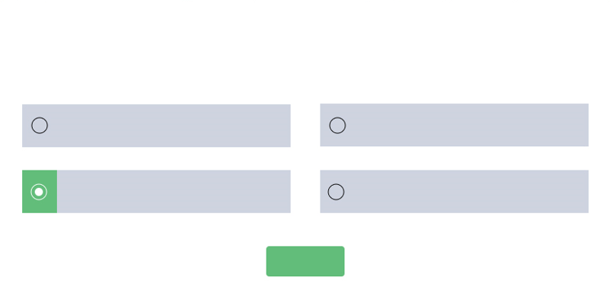
Check Your Knowledge
Brand Logo
Course Objectives
Question
Choose the correct option and then click Submit.
Option 1
Option 2
Option 3
Option 4
Objective 1
Objective 2
Submit
Click on each tab to learn more
Notes:
You can insert "Check Your Knowledge" sections between courses for learners to self-assess what they know and receive instant feedback

Slide 7
Assessment
Brand Logo
Course Objectives
Objective 1
Objective 2
Objective 3
Click on each tab to learn more
Notes:
Upon completing the course, incorporate assessments. Assessment is like a test or evaluation to see how much learners know about a topic. Provide clear instructions on how to proceed and specify the number of questions required to pass.

Slide 8
Question 1
Brand Logo
Course Objectives
Question no. 1
Choose the correct option and then click Submit.
Option 1
Option 2
Option 3
Option 4
Objective 1
Objective 2
Objective 3
Submit
Click on each tab to learn more

Slide 9
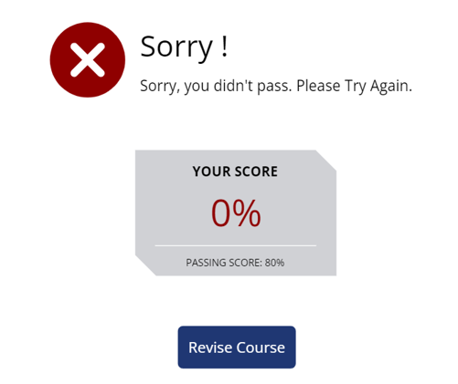
Brand Logo
Course Objectives
Click on each tab to learn more
Notes:
Based on the given answers by the learner, evaluate whether the learner passed or failed the course.

Slide 10
Thank you
Brand Logo
Course Objectives
Click on each tab to learn more
Notes:
Conversely, if the learner successfully completes the course, conclude with a thank-you slide.

